Slide 1
Multi-Task LLMs: What Can Pruning Tell Us?
Abhinand, Andrew, Brianna, Diya
Notes:
Andrew

Slide 2
Introduction
Fine tune BERT for particular tasks
Prune each of those tasks
Do tasks respond differently to pruning?
Notes:
Andrew

Slide 3
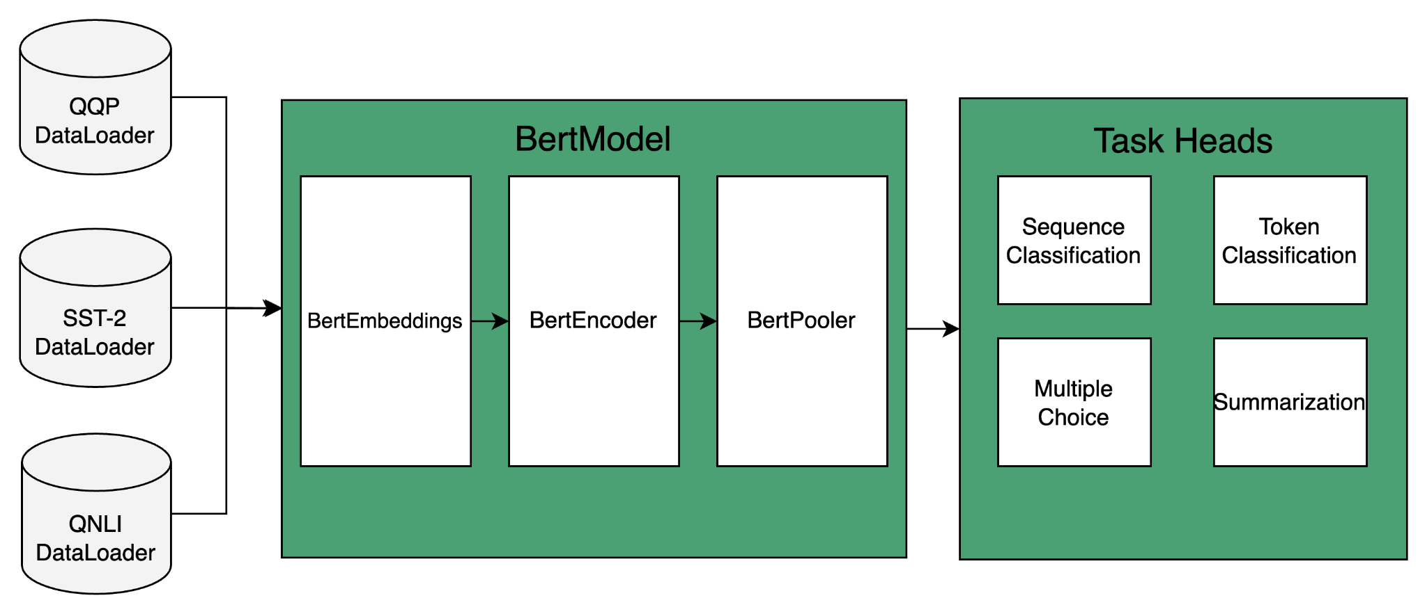
Multi task model
Notes:
Abhi

Slide 4
Tasks
SST-2
QQP
QNLI
Predict the sentiment of a given sentence.
Determine whether a pair of questions are semantically equivalent.
Determine whether the context sentence contains the answer to the question.
“a depressed fifteen-year-old 's suicidal poetry”
“What can one do after MBBS?”
“What do i do after my MBBS ?”
“What percentage of the population is of the Rakhine descendant line ?”
“The Rakhine people constitute 4% of the population.”
Notes:
Diya

Slide 5
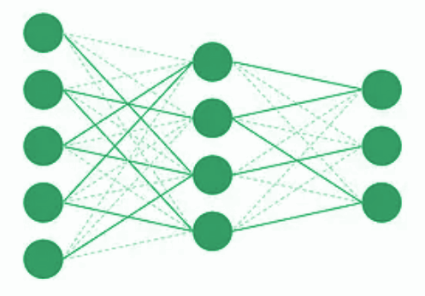
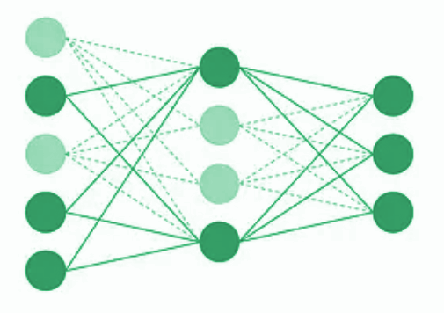
Pruning techniques
Unstructured
Attribution
Prunes out low-magnitude weights
Structured pruning of neurons
Computes the task-specific neuron attribution in each layer
Notes:
Brianna
Pruning of transformer: prune out the encoder layers only (fully connected feed forward and attention
Attribution pruning:
Compute the importance of each neuron in performing a specific task
Based on the attribution scores, prune out neurons
Attribution calculation
forward pass to obtain the network's outputs
backward pass to calculate the gradients of the loss with respect to each neuron's activation.
The attribution scores of each neuron are aggregated over multiple inputs, i.e. the entire training dataset, to indicate the importance of each neuron for the given task.

Slide 6

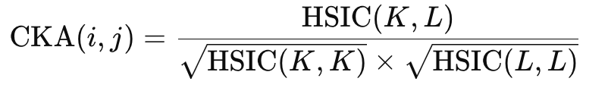
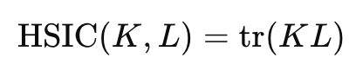
Evaluation: Centered Kernel Alignment (CKA)
Problem: How to compare the baseline and pruned network?
Accuracy works, but what if we want more information?
Solution: Compute the similarity of feature representations of both network’s encoder layers
How: Use CKA → HSIC (Hilbert-Schmidt Independence Criterion)
Anand Subramanian. torch_cka. 2021. Available at: https://github.com/AntixK/PyTorch-Model-Compare
Notes:
Andrew:
At this point we have the model and the pruning methods, but how do we evaluate one against the other?
The de facto standard is to use accuracy, but that gives limited understand of how or why things are changing, just that the model degrades at some point.
If we view BERT’s various encoders as highly complex feature extractors, it is natural to want to study the feature representations of the encoders at various stages of pruning.
The Centered Kernel Alignment (CKA) allows us to do that.
HSIC measures interdependence between two distributions

Slide 7
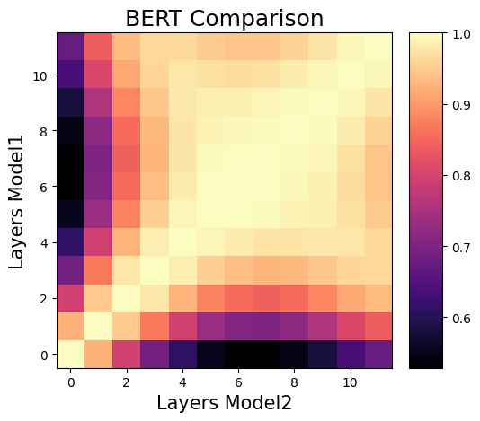
Interpreting CKA’s Output
Notes:
Same model being compared to itself
High intensity (near 1) means the features are very similar to each other. Low intensity is in dark purple.
Diagonal the same + symmetric. Indication that the calculation is working properly.

Slide 8
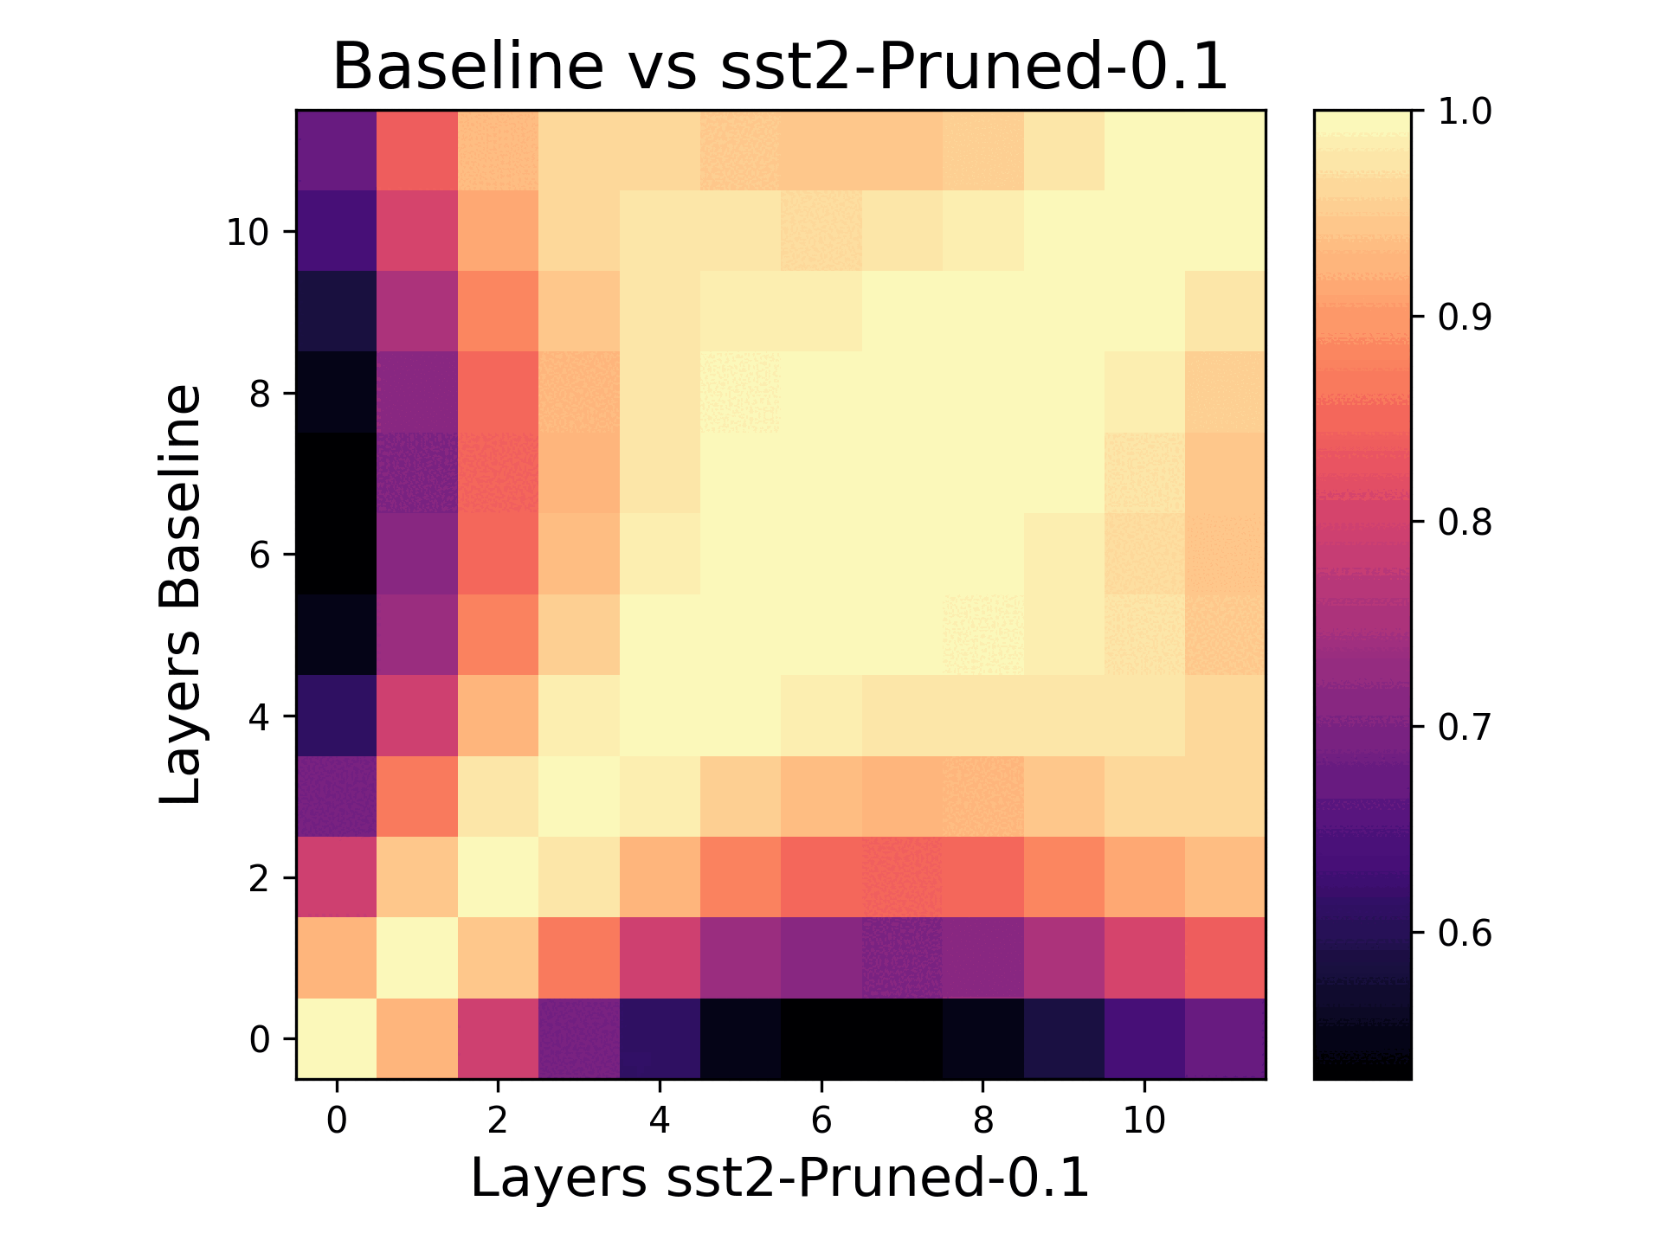
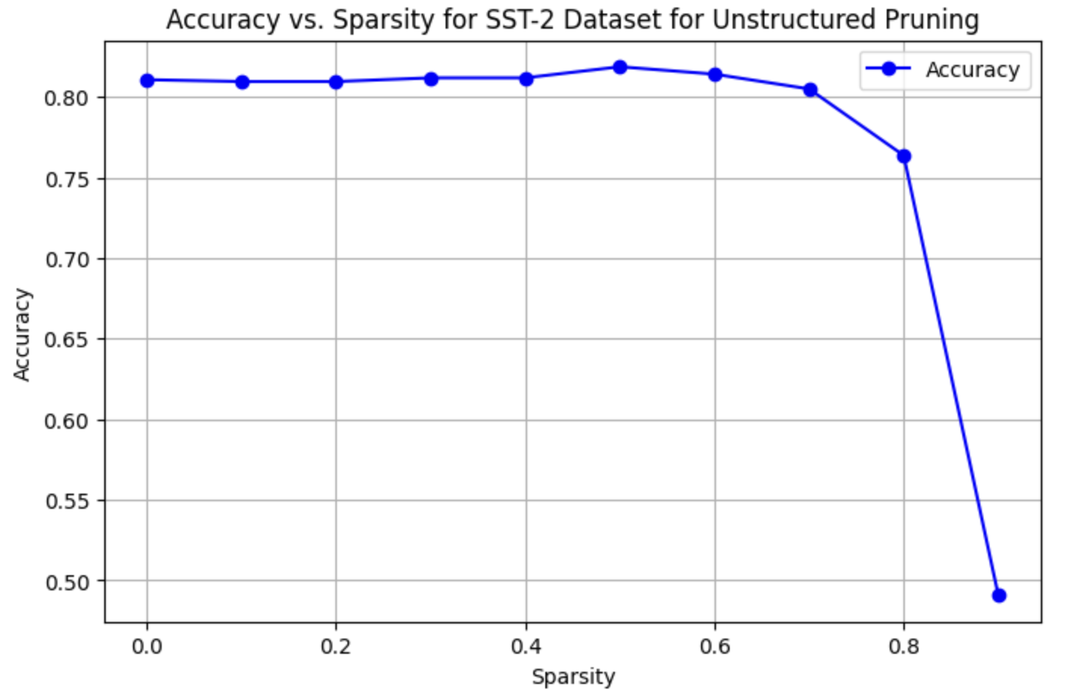
SST-2 - Unstructured Pruning
Notes:
Key Observations:
SST-2 is robust to pruning
Feature representation doesn’t change significantly until 60% encoder sparsity
Early encoder layers are pruned more heavily
Possible that those attention heads weren’t as relevant to SST-2
Mid-level encoders (5-8) are important for the SST-2 task
After 80% encoder sparsity, initial feature representation is lost
Representational power decreases because every layer’s representation in the pruned model is similar to the earliest layer of the baseline at 90% sparsity.

Slide 9
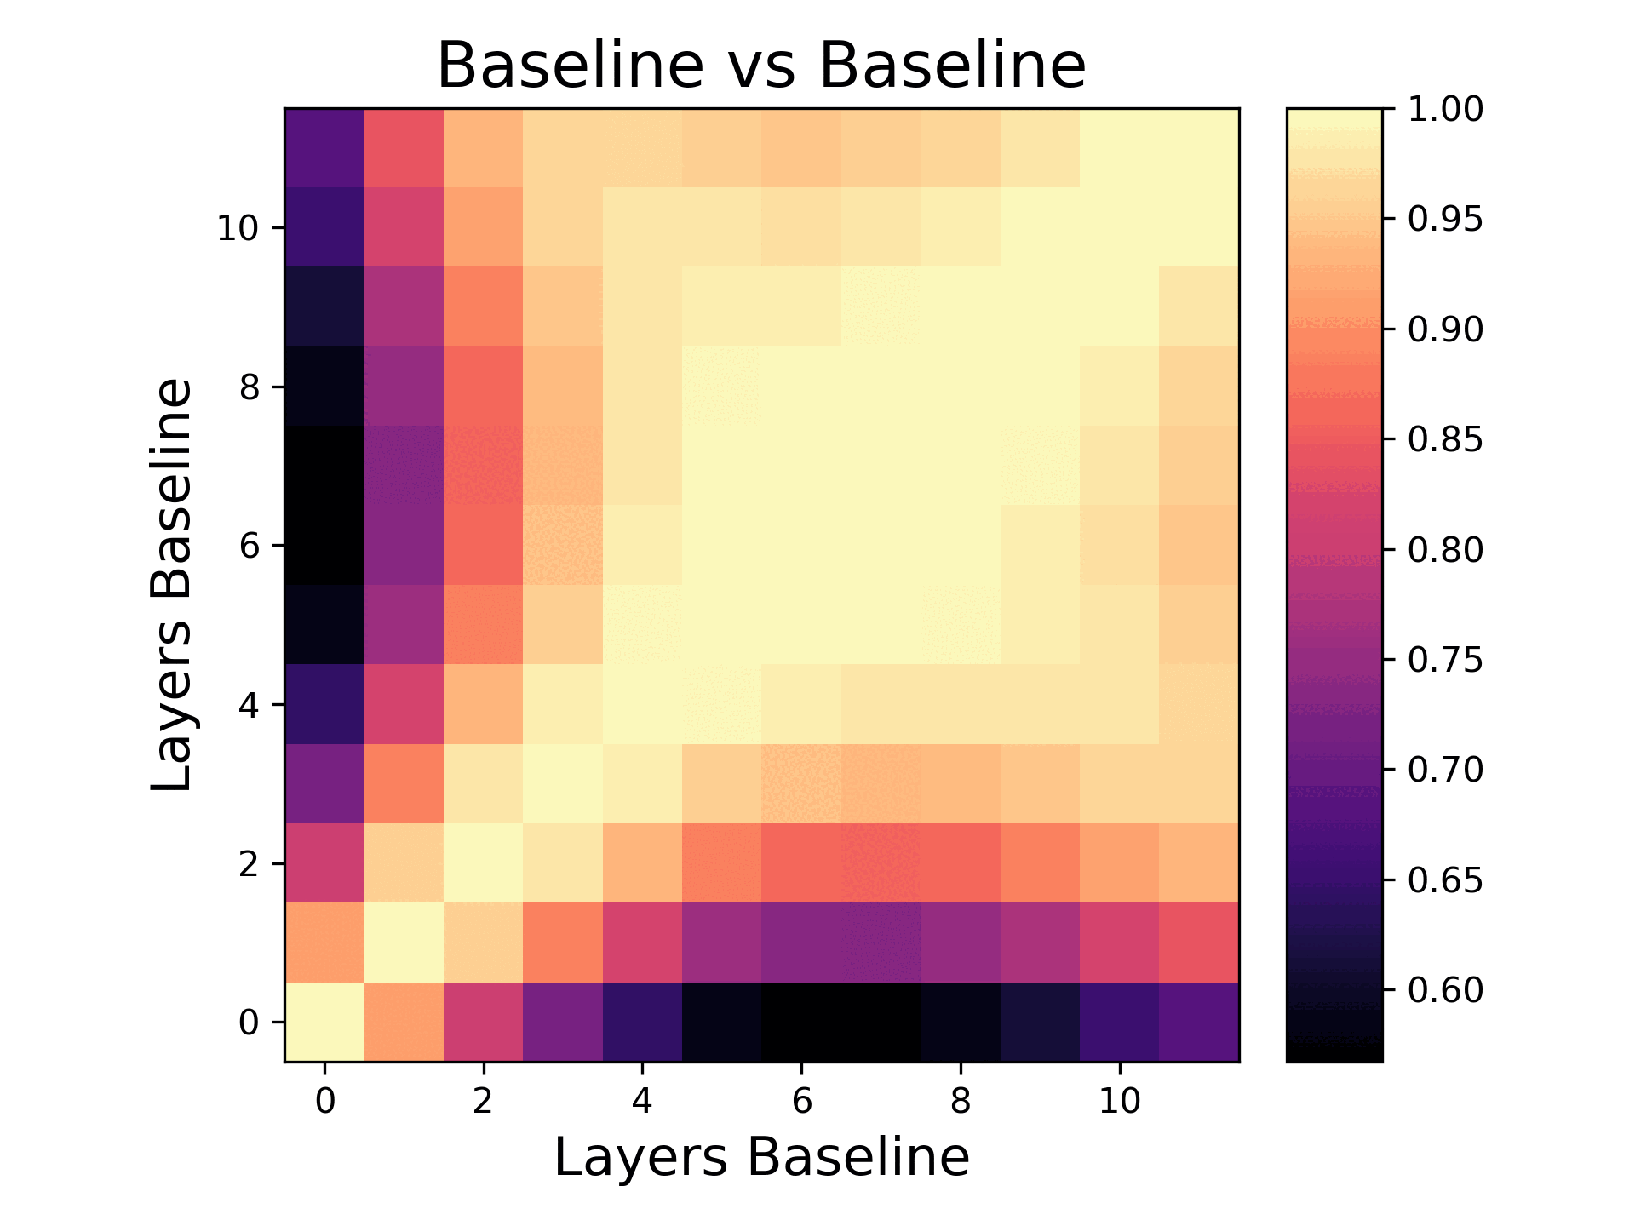
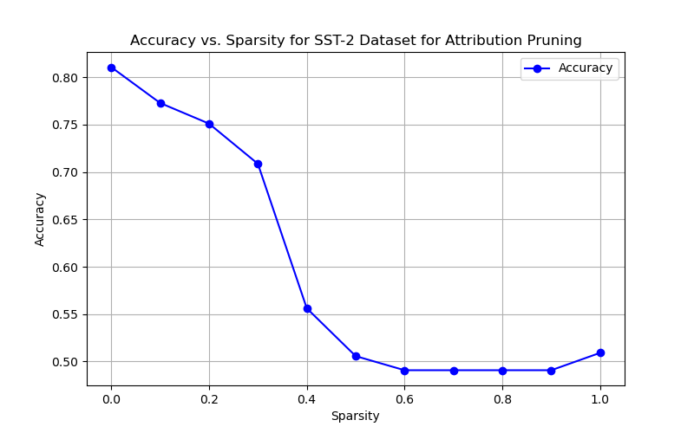
SST-2 - Attribution Pruning
Notes:
Brianna
Threshold: ~0.3-0.4

Slide 10
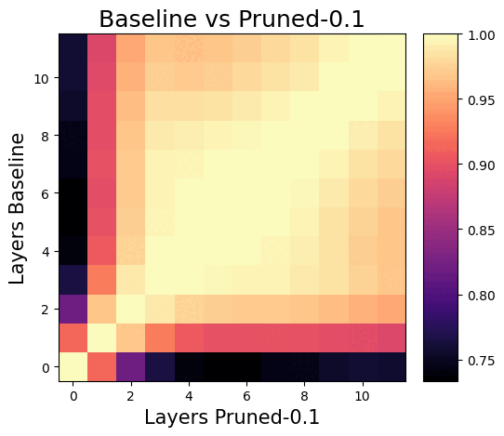
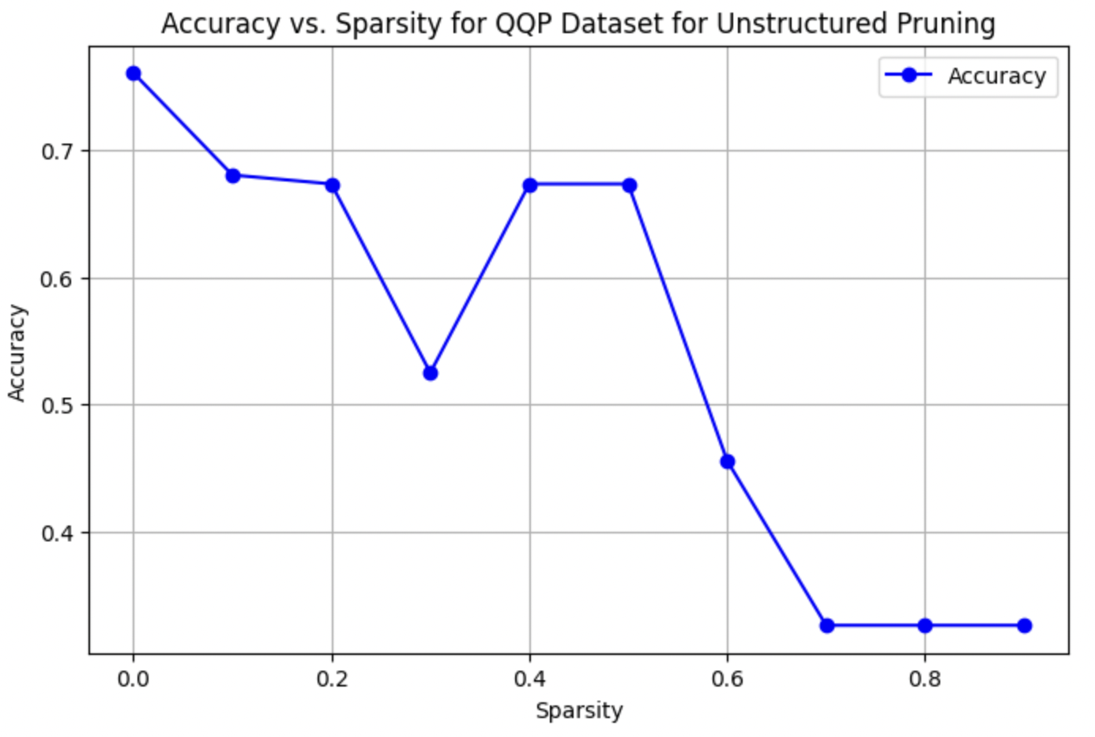
QQP - Unstructured Pruning
Notes:
Abhi
Preserving the integrity of lower layers becomes crucial for maintaining functional similarity to the baseline model.

Slide 11
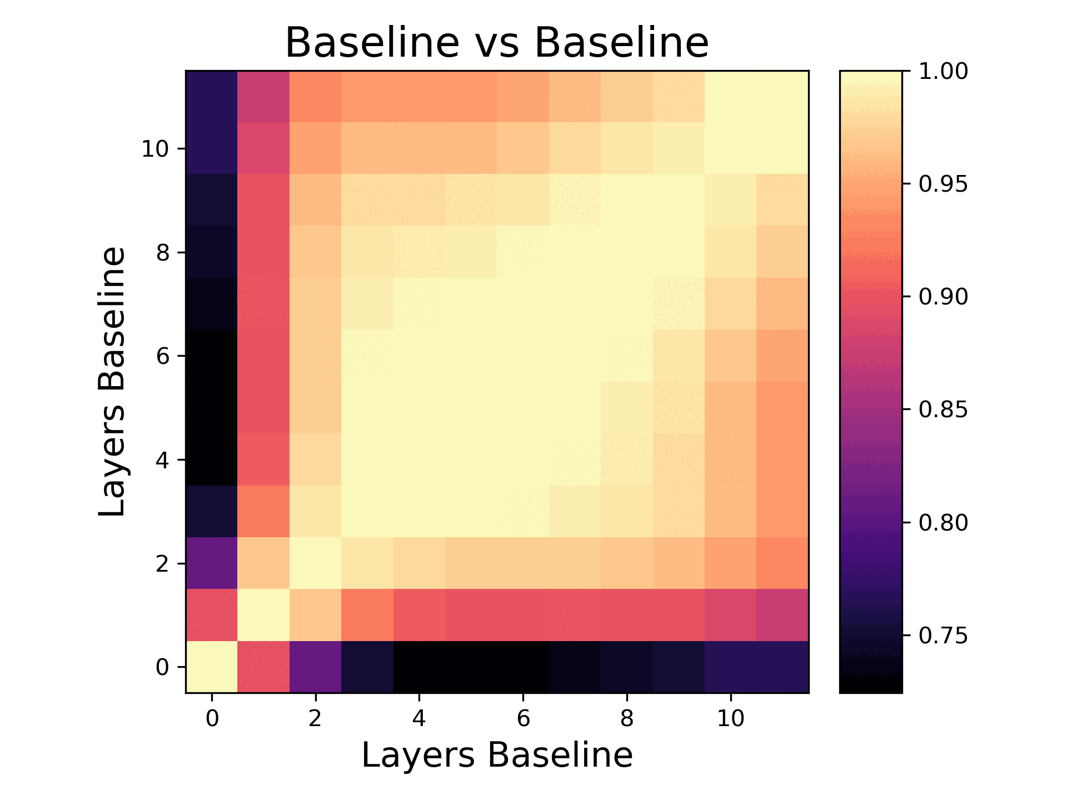
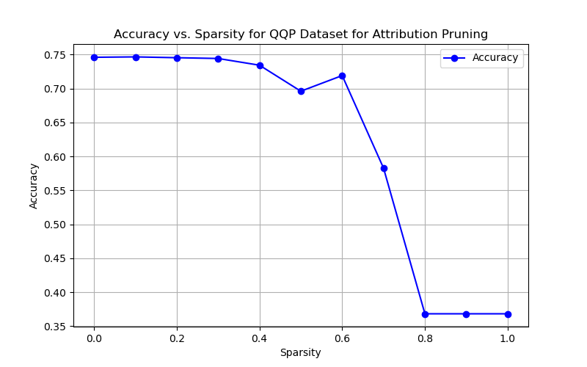
QQP - Attribution Pruning
Notes:
Brianna
Possible threshold: 0.6

Slide 12
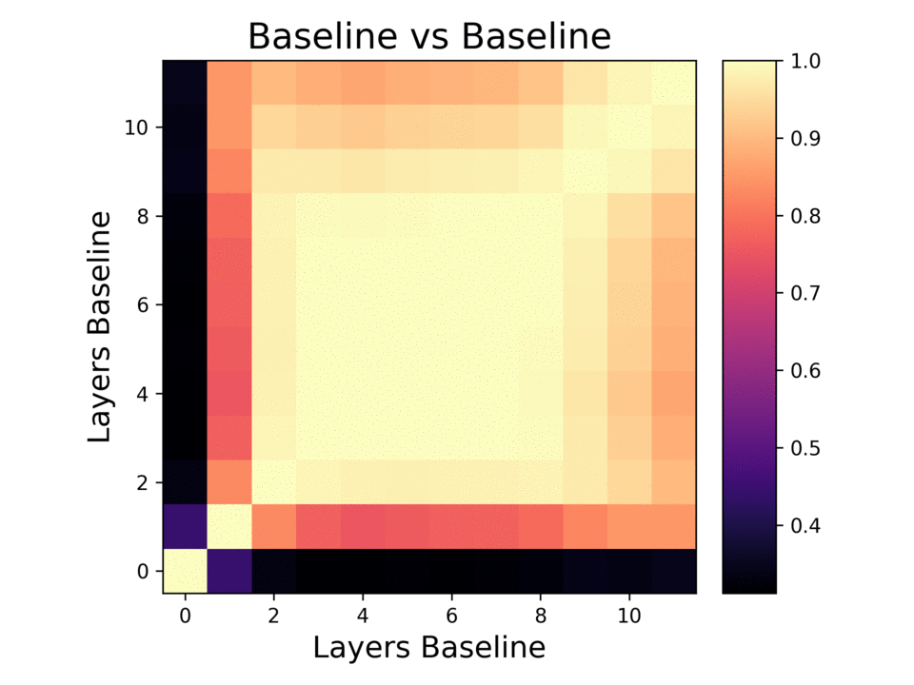
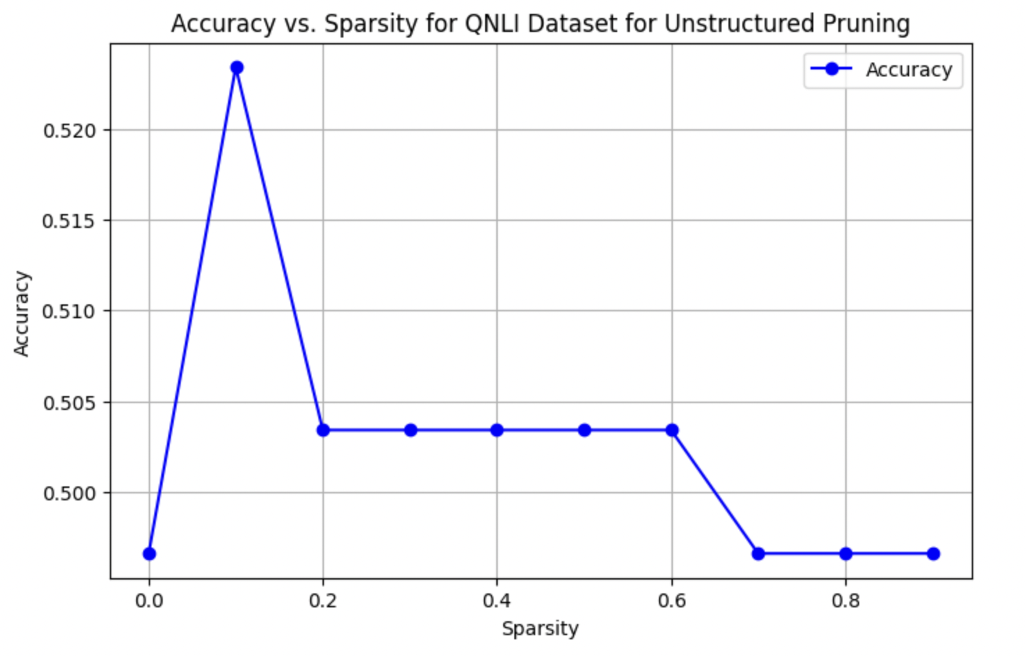
QNLI - Unstructured Pruning
Notes:
Abhi
0.6 could be an optimal threshold (accuracy degrades after that)
Mid-level encoders in neural networks often capture semantically rich representations that balance between low-level features and high-level abstractions. The increased similarity among mid-level encoders indicates that these layers might contain more robust and generalizable information compared to other layers

Slide 13
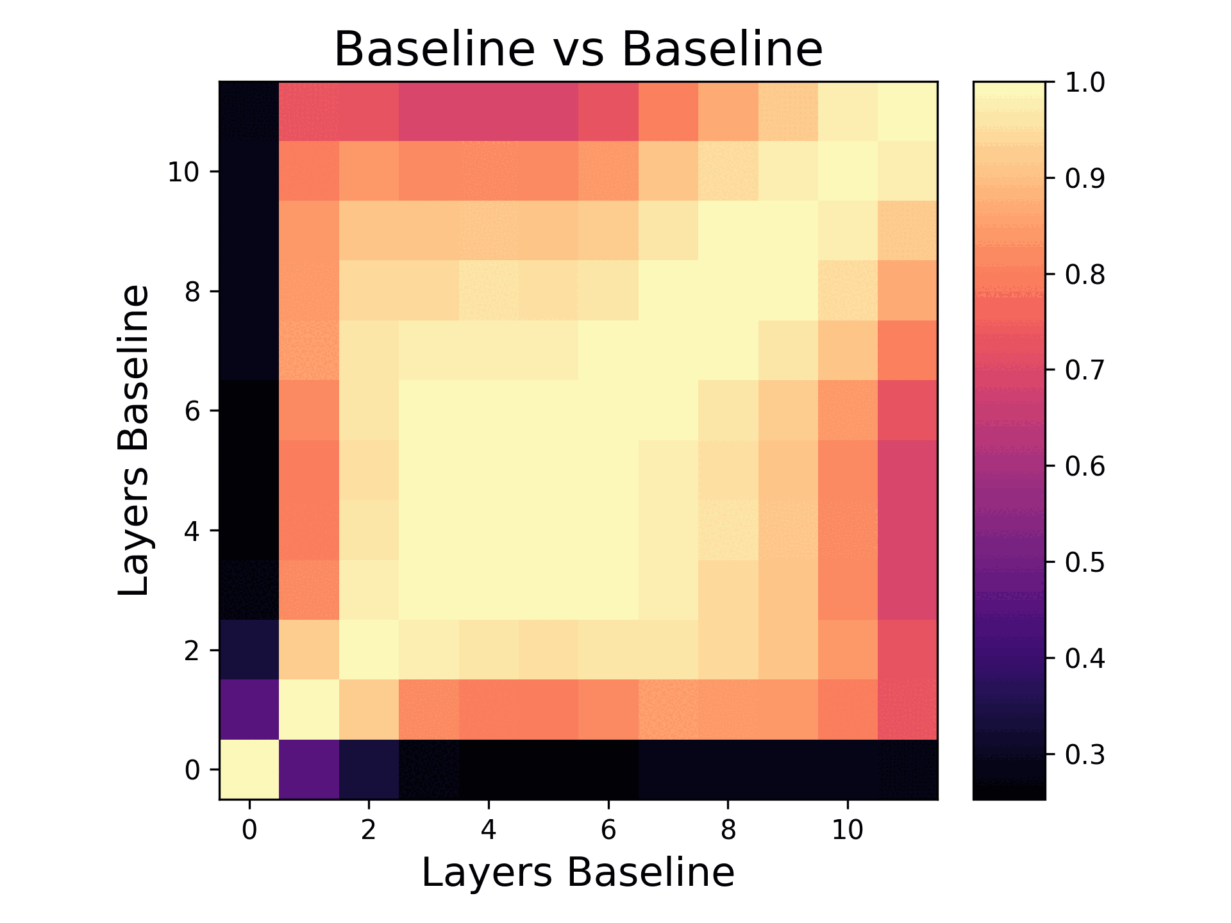
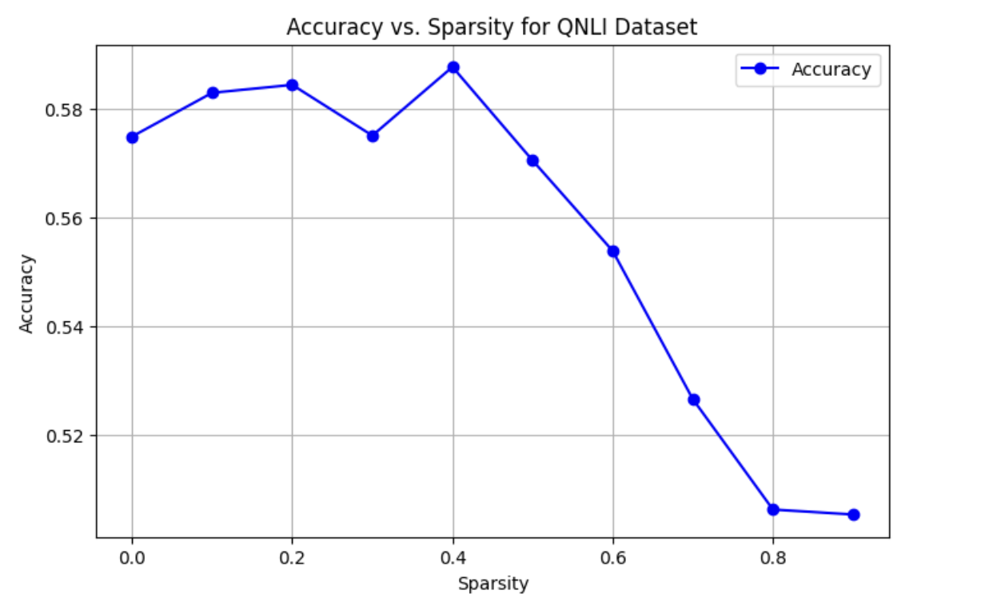
QNLI - Attribution Pruning
Notes:
Diya

Slide 14
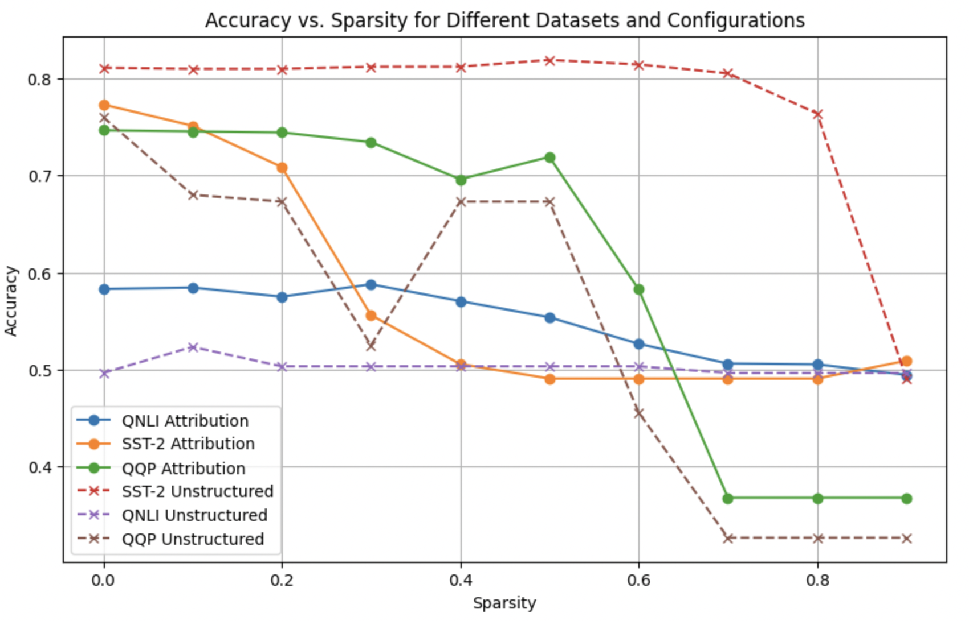
Accuracy Analysis
Notes:
Abhi
QNLI (Question Natural Language Inference) and QQP (Quora Question Pairs) are both tasks that require understanding relationships between pairs of sentences. They involve tasks like determining semantic similarity or entailment. This could mean that for these tasks, the model's performance is more sensitive to specific important features, making attribution pruning, which focuses on preserving key influential weights, more effective.
SST-2 involves sentiment classification, which might depend on broader, less sparse patterns (such as overall sentence structure or common sentiment-indicative words) that are less disrupted by unstructured pruning.

Slide 15
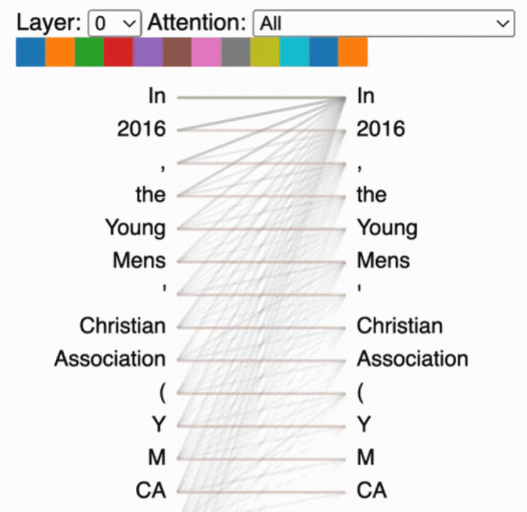
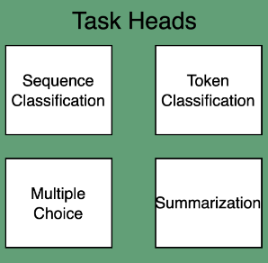
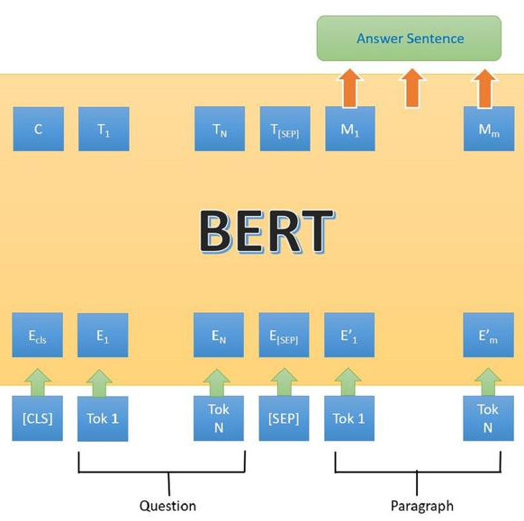
Future Work
Task heads
Switch task heads
BertViz
Experiment with different task heads
To visualize the pruned attention heads
See whether pruning for one task degrades other tasks
Notes:
diya

Slide 16
Individual Contributions
Diya
Abhinand
Brianna
Andrew
Cleaned datasets
Created data loader
Fine Tuned QNLI and SST on the custom BERT model
Attribution training on QNLI
Generated heatmaps for the same
Create custom BERT model with task
Fine tuned BertModel on QQP and SST-2
Performed unstructured pruning on QQP and QNLI
Generated heatmaps for the same
Implemented code for attribution-based pruning
Attribution pruning on SST-2 and QQP
Generated heatmaps and accuracy plots
Led group through research and implementation
Modified torch_cka to work with BERT
Generated heatmaps and stacked them temporally
Notes:
diya

Slide 17
Conclusion
Each task had a unique response to pruning
Different pruning methods led to different representations on the same task
No global structure across all tasks
THANK YOU!
Notes:
Andrew

